Slide 1
Multi-Drone Coordination for Search and Rescue Missions
Presented to
Flavien Balbo, Olivier Boissier & Luis Gustavo Nardin
Presented By
Nushrat Jahan

Slide 2
Problem Description
Designing a multiagent system using drones that can detect the survivors and deliver food and medication to them in a timely and efficient manner
The drones will have to take food and medications from the distribution center and deliver them to the survivor
Whether drone performs well for a centralized distribution center or decentralized distribution center

Slide 3
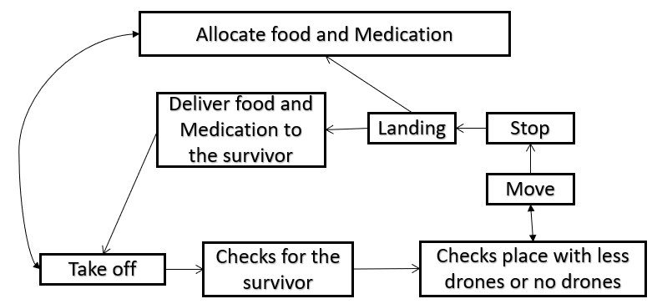
Multiagent Solution
Agent
Drones
Environment
Survivor
Distribution Center
Rescued Survivor
Figure 1: Action model flow diagram

Slide 4
Multiagent Solution
Interaction
Drones will interact with distribution center and survivors
Organization
The drone will go to the distribution center right after becoming empty and after becoming full of food and medication the drone will go to search for survivors.
The drone should detect the survivors and their location accurately.
The drone should be able to deliver food and medication to the survivors.
The drone should optimize the search and rescue mission.

Slide 5
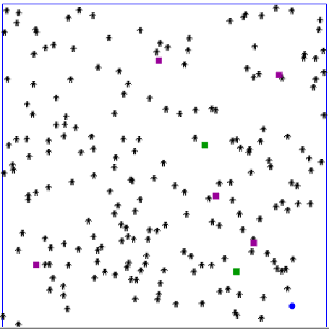
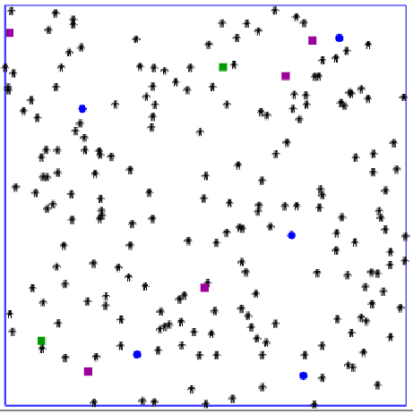
Scenario
Fig 1: 200 suvivors, 2 rescued survivors, 5 drones, 1 centralized distribution center
Fig 2: 200 suvivors, 2 rescued survivors, 5 drones, 5 decentralized distribution center
Notes:
We have an initial scenario where we have 200 survivors, 5 drones, 2 rescued survivors and a centralized distribution center.
In the next scenario, we have 200 survivors, 5 drones, 2 rescued survivors and 5 decentralized distribution centers. The icon values are same for each objects.

Slide 6
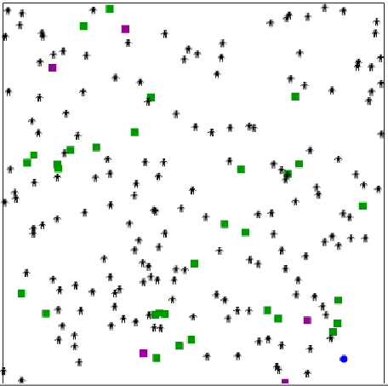
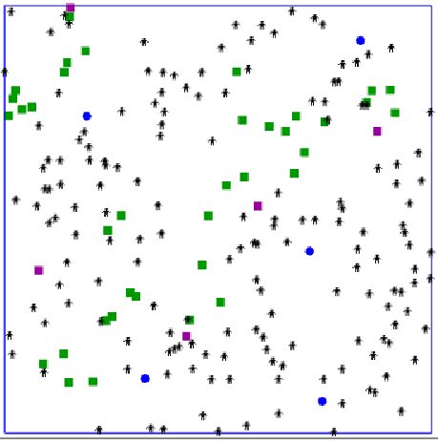
Result
Fig: Performed on 100 tiks in a centralized distributed system survivor count 170 and rescued 32
Fig: Performed on 100 tiks in a 5 decentralized distributed system survivor count 165 and rescued 37
Notes:
For the first scenario we ran our simulation for 100 tiks and got result where the drone could rescue total 32 survivors and the updated survivor number was 170. As the activities only affect the survivor number and rescued survivor number, so these two values were changed rest were same as initial.
For the second scenario we ran our simulation for 100 tiks and got result where the drone could rescue total 37 survivors and the updated survivor number was 165. As the activities only affect the survivor number and rescued survivor number, so these two values were changed rest were same as initial.

Slide 7
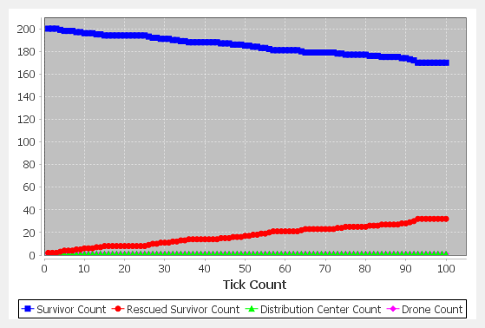
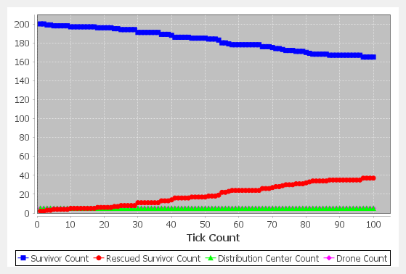
Result & Discussion
Fig: Performed on 100 tiks in a centralized distributed system survivor count 170 and rescued 32
Fig: Performed on 100 tiks in a 5 decentralized distributed system survivor count 165 and rescued 37
Notes:
So, within these two cases we can see the decentralized system gives good result than the centralized system. The change is 5% for this scenarios. We need to check the simulation again and again and we an give a predictive solution.

Slide 8


